Slide 1
University American College Skopje
Course: Business Computer Applications
Practical uses of AI ChatGPT, Copilot and Bots in business
Marija Stanojeska, PhD

Slide 2
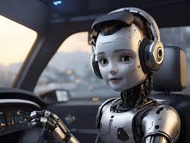

Slide 3
Lecture overview
Explanation of AI Chat GPT.
Description of Copilots.
Explanation of Bots and types of Chatbot function and evolution.
Discussion the advantages and disadvantages of Chatbots.
Explanation of the Chat GPT features and applications in education.

Slide 4
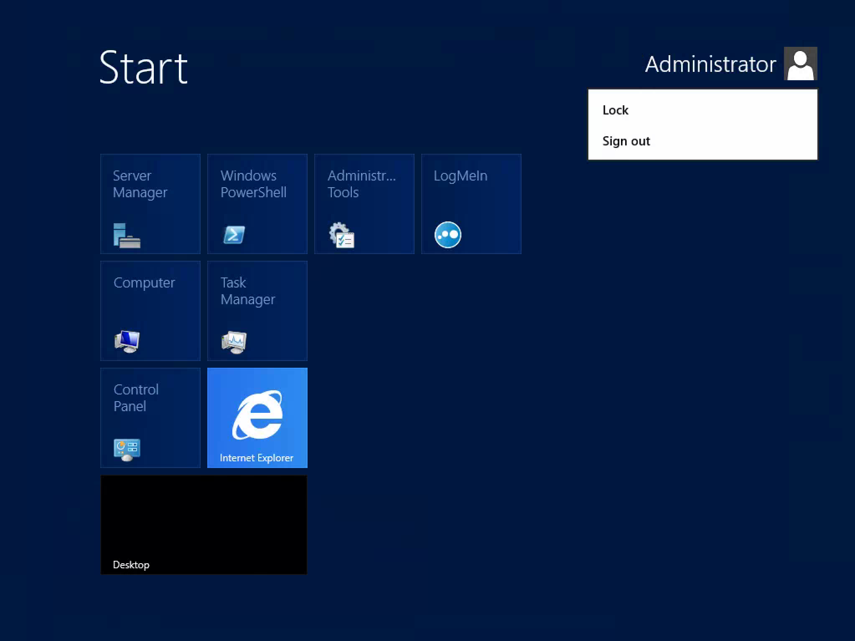
ChatGPT

Slide 5
What is ChatGPT?
ChatGPT is a conversational AI model developed by OpenAI. It's based on the GPT (Generative Pre-trained Transformer) architecture, which is designed to generate human-like text based on the input it receives. ChatGPT can engage in conversations, answer questions, write essays, assist in coding, and perform various other tasks that involve natural language processing.
As a result, ChatGPT can create more ‘human-like’ replies, thus ensuring realistic discussions with customers. Compared to most AI chatbots, ChatGPT learns from previous conversations, making user experiences more personalized. The natural language processing capabilities of GPT-4 (the language model behind ChatGPT) can be used for a wide range of business tasks.

Slide 6
Practical applications of Chat GPT in business
Prompt customer support
ChatGPT-powered virtual assistants are available 24/7 and can answer customer inquiries on various topics. As they continue learning, the range of questions these virtual assistants can handle grows constantly. Moreover, they provide answers almost instantly, which reduces average waiting times for customers to milliseconds. The answers given are always accurate, which human agents cannot guarantee.
Reduced operational costs
By automating the customer support service, you no longer need fully-staffed support teams, which allows you to reduce labor costs. Automated support agents provide your business a lifeline at peak times. They can handle a large number of interactions simultaneously, minimizing the need to scale up your support team.

Slide 7
Practical applications of Chat GPT in business
Increased employee productivity
ChatGPT is an ideal solution to automate repetitive tasks, answer frequently asked questions, schedule meetings and/or appointments, and perform other mundane duties. At this point, your employees can focus on more strategic tasks rather than dedicate their time to these issues.
Personalized customer experiences
Modern AI capabilities granted by ChatGPT provide customer-tailored responses, recommendations, product offers, and solutions based on their behavior and preferences.
Process automation
Given all the benefits you’ve read about, imagine how powerful ChatGPT can become when it’s integrated with a multifaceted enterprise-level system like a CRM or ERP. Thanks to its automation capabilities, ChatGPT can help in performing order management, data entry, customer relations, HR, onboarding, IT support, and other business processes much faster, more accurately, and much faster and more accurately than ever before.

Slide 8
Practical applications of Chat GPT in business
Confident decision-making
ChatGPT can process data from various sources, summarizing and delivering relevant information to provide you with insights to make informed business decisions. ChatGPT is updated regularly, meaning that its data resources are always accurate and up-to-date.
Ideation medium
When it comes to brainstorming, ChatGPT gives you plenty of space for creativity and even suggests ideas that you can consider. Whether you need to devise a customer engagement strategy, plan to present new service offerings, or add new features, ChatGPT can help. That is, it gives you unlimited benefits of data analytics.
Automated compliance
You can program ChatGPT to strictly follow industry regulations and internal policies.it will ensure all your written communications are always compliant. One can hardly underestimate the efficiency of this solution, as it saves you trouble of performing regular compliance audits or hiring an outside counsel for this purpose.

Slide 9
Copilots

Slide 10
What is Copilot?
Copilot is an AI-powered coding assistant developed by GitHub in collaboration with OpenAI. It's integrated directly into code editors like Visual Studio Code and helps developers by suggesting code snippets, completing code, and even generating entire functions or classes based on the context. Copilot leverages the GPT architecture to understand and predict what a developer might need next, thus improving productivity and reducing the time required to write and debug code.
Copilot is an AI chatbot similar to ChatGPT, but it can be used to automate tasks, access data, generate insights, and assist with tasks to reduce employee manual work.
Some key features and general uses of Copilot are:
It can read and summarize PDFs and provide bullet points of significant takeaways.
Copilot can answer any question about current events, history, random facts, and more - concisely and conversationally.
It is run on the powerful GPT-4 AI model and earns trust with its consistent source citations.
Copilot can analyze the current web page or user’s article user and summarize the content.

Slide 11
Practical applications of copilot in business
Speeding Up Development
  Copilot accelerates the development process by suggesting code snippets, reducing the time spent on writing repetitive code.
Improving Code Quality
  Copilot suggests best practices and optimizations, helping developers write cleaner and more efficient code.
Supporting Learning and Collaboration
  Copilot aids junior developers in learning programming languages and coding practices by providing real-time examples and explanations.

Slide 12
Specific use cases for Copilot
Create AI-generated images
Users can use Bing to create AI-generated images within the Copilot window. This feature allow users to generate unique and creative graphics using plain English prompts. For example, user can type “Can you generate a photo-realistic image of a businesswoman working on her Windows PC using AI tools?” and get following image…

Slide 13
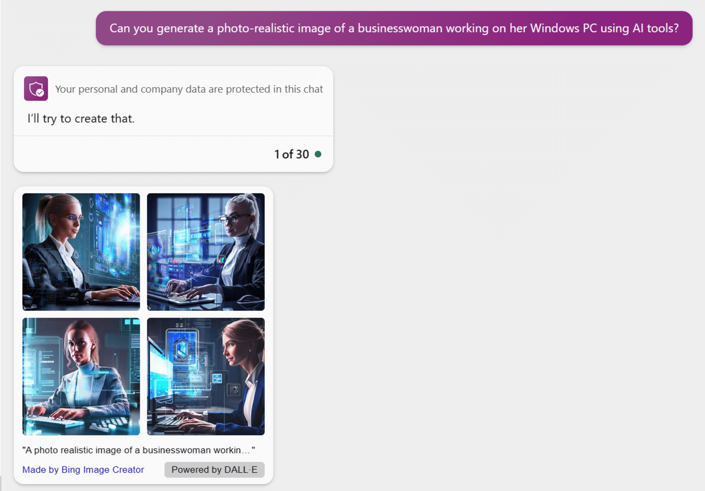
You can learn more about Microsoft Designer and DALL-E from
https://create.microsoft.com/en-us/learn/articles/how-to-image-prompts-dall-e-ai

Slide 14
Real-time competitive intelligence
Copilot can be valuable for gaining real-time competitive intelligence using AI techniques and web data.
For example, a marketing analyst needs to research a competitor’s new product launch. The analyst asks Copilot about the product’s pricing, features, and launch strategy. Based on natural language processing, Copilot understands the intent and responds with a summary of the most relevant information it finds across the web, like press releases, product reviews, and industry analysis.
Copilot can provide rapid insights by applying AI approaches such as machine learning to analyze a pool of unstructured web data quickly. The analyst can then ask more questions to investigate the competitor’s marketing messaging, positioning, and potential vulnerabilities. This AI-augmented access to continuously updated web data helps the analyst efficiently conduct competitive research and identify the strategic insights in real-time.

Slide 15
Comparing AI Chatbots for Business: Copilot and ChatGPT Features
Copilot benefits
Streamlined workflows: Copilot can automate tasks and access data to reduce an employee’s manual work. This can improve productivity.
Up-to-date information: Since Bing is a search engine, the chatbot can provide real-time data from the web. This ensures accurate, current information.
Enhanced security: Copilot offers encrypted chat data and built-in privacy features to prevent leaks. It also has limited access and commercial data protection.
Customizable options: Bing provides three chat modes and AI fine-tuning options to optimize the bot for different needs. ChatGPT does not have customizable settings.
ChatGPT benefits
More conversational: ChatGPT tends to provide longer, more conversational responses that mimic human chats. Bing replies can be more concise.
Broader knowledge: Without web access, ChatGPT relies on its vast training data to answer various questions and scenarios.
Easy to use: ChatGPT does not require any account or integration. Anyone can start chatting with no setup or restrictions.

Slide 16
Copilot vs. ChatGPT for business efficiency (1)
Access and usage limits:
One central distinction between the two AI chatbots is the required access and usage restrictions. Copilot requires a Microsoft account to chat with the bot. Microsoft has also defined usage caps, 30 turns per session and 300 daily chats for account holders.
In contrast, ChatGPT (Free) does not require any account or approval to begin chatting. Any user can go directly to the ChatGPT site and instantly ask questions without usage limits. While the open access boosts the ChatGPT’s popularity, it also makes the bot harder for its creators to control and monitor.

Slide 17
Copilot vs. ChatGPT for business efficiency (2)
Data privacy and security:
Microsoft takes a principled approach to developing responsible AI, and this attitude is reflected in Copilot for enterprise. It provides robust commercial data protection to keep business information secure. The chatbot’s responses are grounded in verifiable web data from reliable sources, not unproven information.
Microsoft created Copilot following its AI principles of fairness, reliability, safety, privacy, security, inclusiveness, transparency, and accountability. The company also works closely with its partner OpenAI to encourage responsible use of the technology.
Additionally, Microsoft heavily incorporates user feedback to improve Copilot before releasing it more broadly, helping ensure it remains trustworthy. Between commercial data protections, web-based responses, ethical AI principles, and extensive user testing, Microsoft has implemented multilayered measures to deliver a safe Copilot experience.

Slide 18
Chatbots

Slide 19
What are bots?
Bots, also known as "robots," are automated software programs that perform specific tasks on the internet. These tasks are often repetitive, mundane, or require handling large volumes of data, making bots ideal for automating them. Bots can be simple scripts that follow a set of predefined rules, or they can be more advanced, leveraging artificial intelligence (AI) to interact with users and systems in a more sophisticated manner.
Types of Bots
Chatbots - engage in conversations with users, often providing customer support, answering questions, or assisting with tasks.
Web Crawlers (Spiders) - index web pages for search engines like Google. They scan websites, follow links, and collect data to help build search engine indexes.
Social Media Bots - automate interactions on social media platforms, such as liking, commenting, or following users.
Transactional Bots - automate financial transactions or other repetitive tasks in business processes.

Slide 20
Bots in process automation
Streamlining operations
Bots can automate repetitive business processes like billing, scheduling, and data management.
Reducing costs
It is worth to emphasize the cost savings associated with automating these processes, reducing the need for manual labor and minimizing errors.

Slide 21
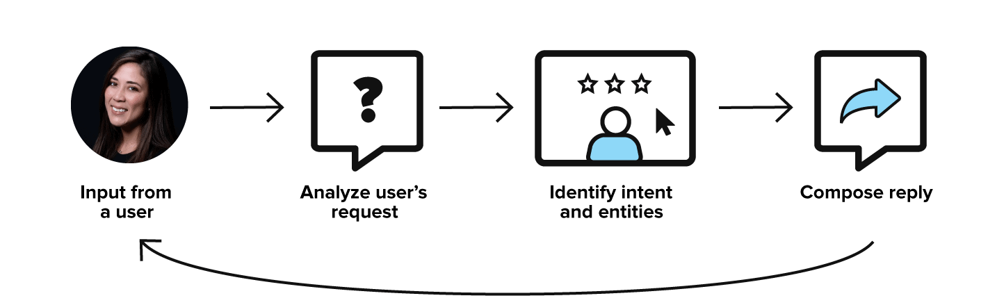
What is a Chatbots?
A chatbot is a software application that can simulate human conversation with an and user. It can chat with a user in different languages and providing instant and consistent responses without human intervention. This flexibility makes them usable across a wide range of use cases and industries.
Though not all Chatbots are equipped with artificial intelligence (AI), modern Chatbots increasingly use conversational AI techniques like natural language processing (NLP) to understand the user’s questions and automate responses to them.
Chatbots can make it easy for users to find information by instantaneously responding to questions and requests - through text input, audio input, or both - without the need for human intervention or manual research.

Slide 22
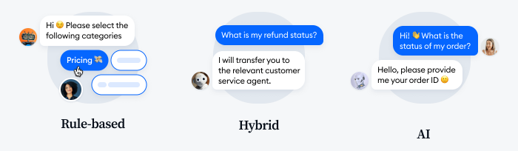
Types of Chatbots

Slide 23
Types of Chatbots
Rule-based chatbots are the ones that give the user a choice of options to click on to get an answer to a specific query. These bots only offer a limited selection of questions, but you can use them to answer your customers’ most FAQs.
Chatbots that use artificial intelligence, natural language processing (NLP), and machine learning understand a variety of keywords and phrases and learn from the visitor’s input. These bots get trained over time to understand more queries and different ways that customers phrase a question.
Hybrid chatbots combine rule-based bots and AI technology. They perform some rule-based tasks, but they can also detect the context and user intent. They are the best-balanced tool for a business to interact with website visitors.

Slide 24
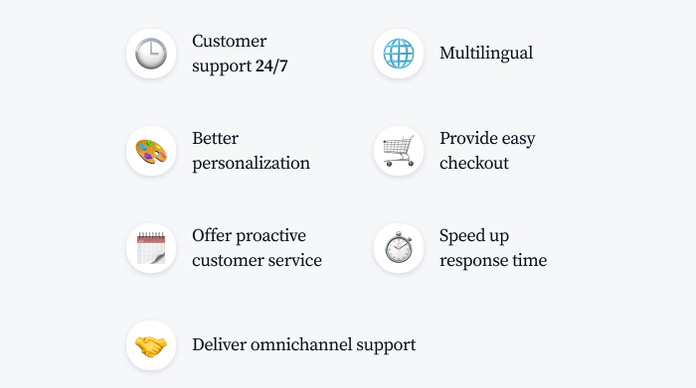
Chatbot benefits for Customers

Slide 25
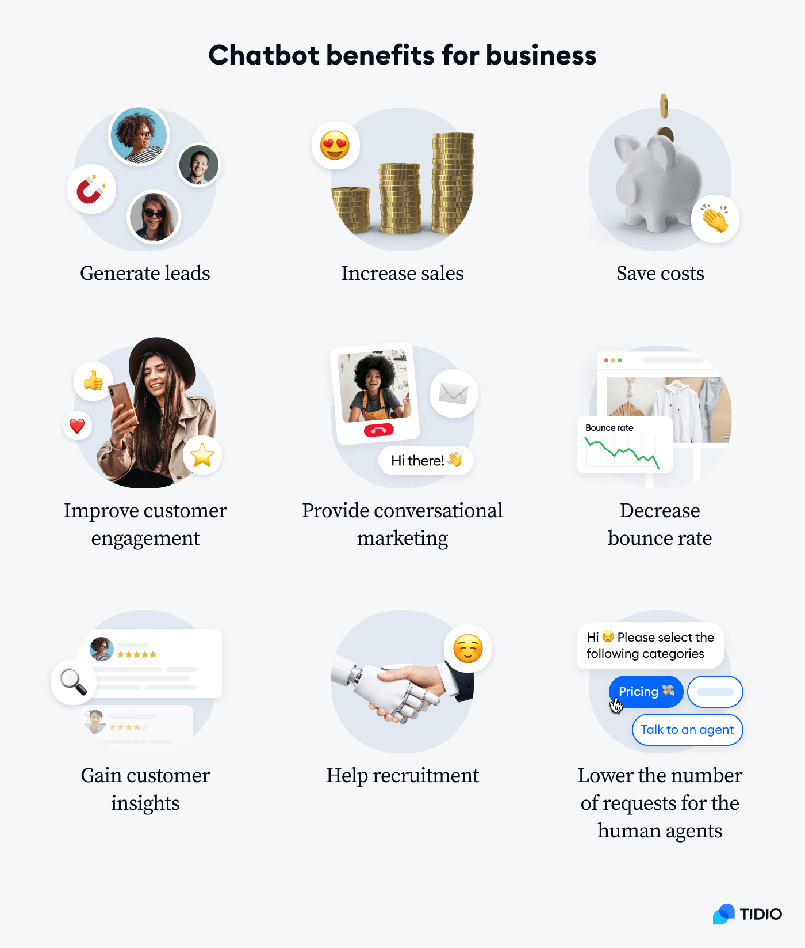
Chatbot benefits for Business

Slide 26
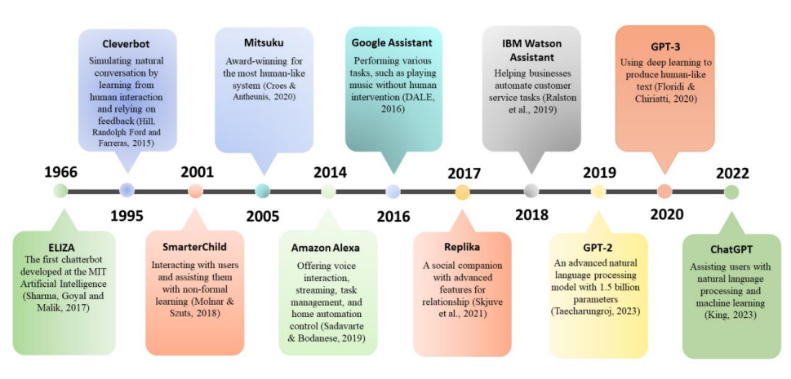
A Summary of well-known Chatbots over time

Slide 27
What is ChatGPT?
ChatGPT is a natural language processing tool driven by AI technology that allows you to have human-like conversations and much more with the chatbot. The language model can answer questions and assist you with tasks, such as composing emails, essays, and code.
ChatGPT was created by OpenAI, an AI and research company. The company launched ChatGPT on November 30, 2022.
The GPT stands for "Generative Pre-trained Transformer," which refers to how ChatGPT processes requests and formulates responses. ChatGPT is trained with reinforcement learning through humen feedback and reward models that rank the best responses. This feedback helps augment ChatGPT with machine leraning to improve future responses.
ChatGPT uses deep leraning, a subset of machine learning, to produce humanlike text through transformer neural networks. The transformer predicts text - including the next word, sentence or paragraph - based on its training data's typical sequence.

Slide 28
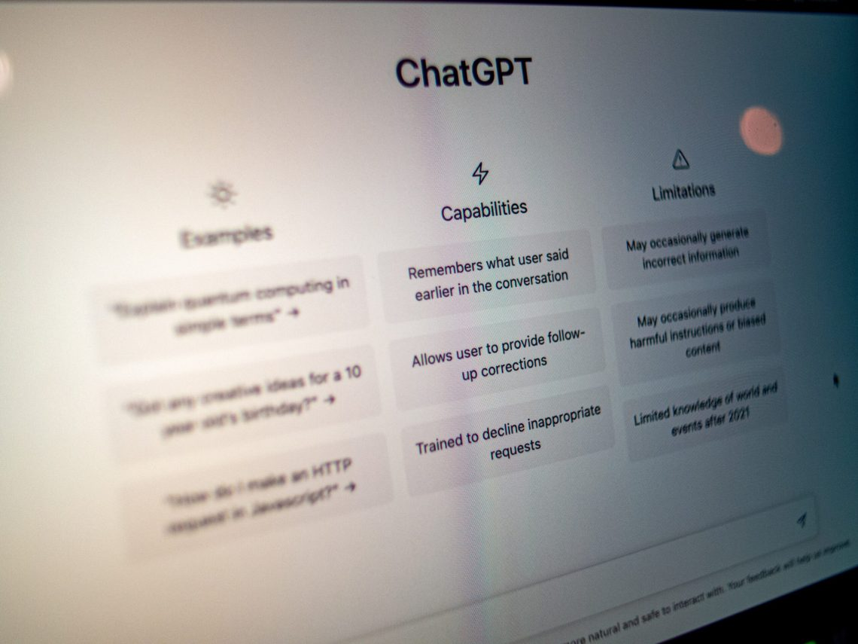
What can ChatGPT do?
It answer questions efficiently on a wide range of topics.
  Questions answering
  Conversational modelling
  Text completion
  Text generation
  Transaction
  Sentiment Analysis

Slide 29
Features of ChatGPT
It understand overall context of query or conversation and generate specific response which are relevant to the topic;
It has ability to learn from previous conversations and utilizes the same to provide relevant responses to any future queries based on learning;
It continuously improves over time and becomes more effective Chatbot;
It can be used as language learning tool;
It can be used as language translation tool.

Slide 30
Advantages and disadvantages of ChatGPT
Advantages
It provides specific responses to users queries.
It remembers the interactions that it had previously with the user in the same prompt tree and utilizes it to provide information surrounding those responses.
It allows users to have follow-up corrections until user satisfied with responses.
Disadvantages
It may generate incorrect information occasionally. Hence validate response yourself specifically when it involves calculations or formula or language related code examples to specific queries such MATLAB or python codes.
It can be manipulated to violate the polices and restrictions that has been enforced on it by using cleverly-thought responses.
It has limited knowledge of latest technologies and events which are yet to be trained on the model.

Slide 31
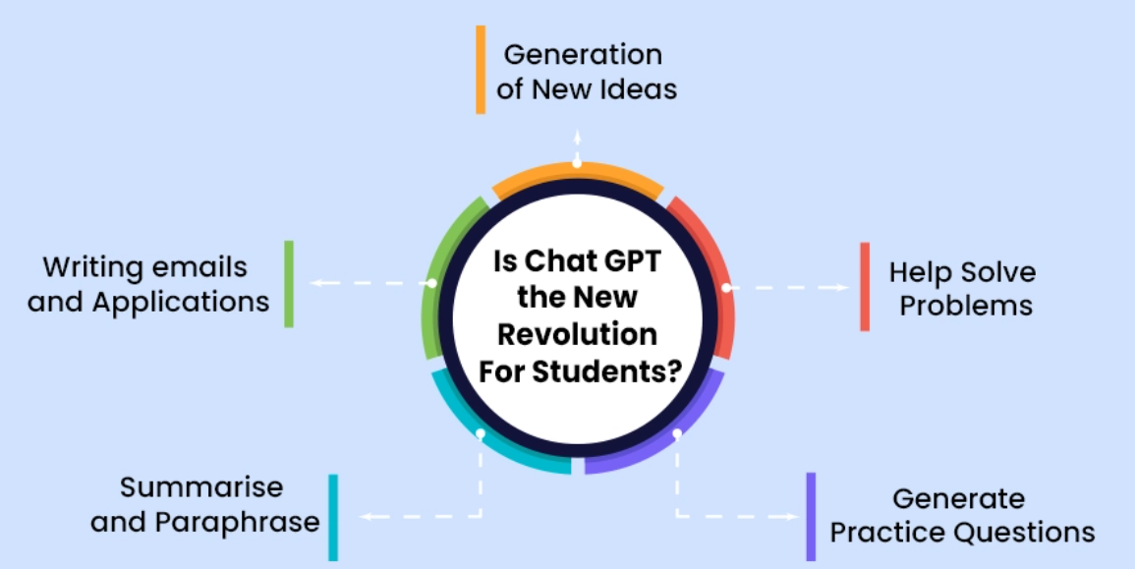
Way to use ChatGPT?
Instant access to information
Encourages active learning
Personalize the learning experience.
Promotes accessibility and inclusion
Enhance learning through AI conversation
Generate ideas for creative stories
Generate ideas for stories and responses for homework and assignment
Manage and write applications and mails
Summarize the class notes
Use a spelling and grammar checker

Slide 32
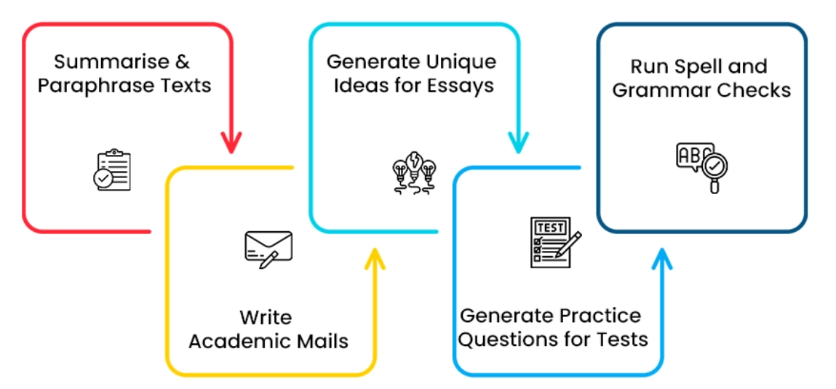
Way to use ChatGPT? (cont.)

Slide 33

Exercise: The synergy of ChatGPT, Copilot, and Bots
  Explain how businesses can leverage the strengths of ChatGPT, Copilot, and bots together to create a more cohesive and efficient operation by providing an example of how a company might use ChatGPT for customer communication, Copilot for software development, and bots for process automation, creating a seamless workflow.

Slide 34
Useful links
Sources:
https://www.techtarget.com/searchenterpriseai/definition/AI-Artificial-Intelligence
https://www.analytixlabs.co.in/blog/components-of-artificial-intelligence/
https://www.javatpoint.com/artificial-intelligence-interview-questions
https://arxiv.org/ftp/arxiv/papers/2304/2304.05436.pdf
https://www.tidio.com/blog/benefits-of-chatbots/
https://www.zdnet.com/article/what-is-chatgpt-and-why-does-it-matter-heres-everything-you-need-to-know/
Videos:
Machine Learning and Human Bias
https://www.youtube.com/watch?v=59bMh59JQDo
How Cambridge Analytica Used Algorithms To Trawl Through Facebook User Data | Mach | NBC News
https://www.youtube.com/watch?v=olysFQkYkCA&t=16s

Slide 35
Thank you for your attention!

